Slide 1


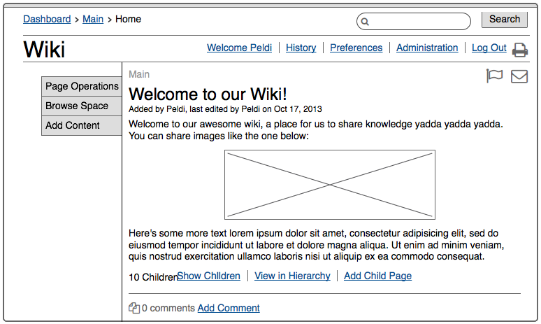
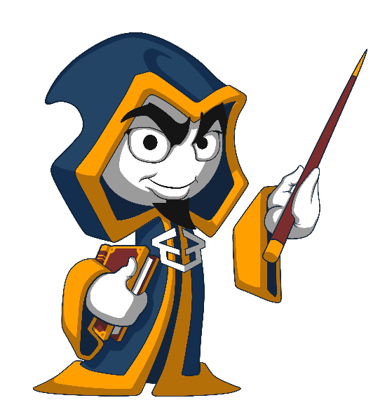
Software Requirements and UI Prototyping
Creating UI Prototypes
UI / UX Sketches
SoftUni Team
Technical Trainers
Software University
http://softuni.bg

Slide 2


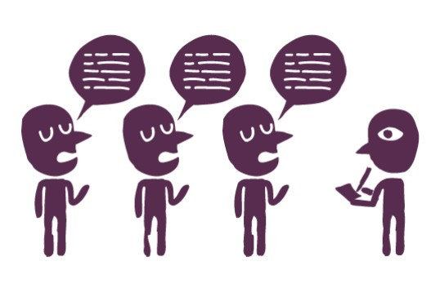
Table of Contents
Software Engineering – Overview
Requirements Analysis, Design, Construction, Testing, Deployment
Software Requirements Analysis
Agile Requirements and User Stories
UI Prototyping
UI Prototyping Tools

Slide 3
Have a Question?
sli.do #softuni-teamwork

Slide 4

Software Engineering
Requirements, Design, Construction, Testing

Slide 5


What is Software Engineering?
Software engineering is the application of a systematic, disciplined and quantifiable approach to the development, operation, and maintenance of software.
Definition by IEEE

Slide 6


Software Engineering
Software engineering is:
An engineering discipline that provides knowledge, processes, tools, and methodologies for:
Defining software requirements
Performing software design
Software construction
Software testing and QA
Software maintenance tasks
Software project management

Slide 7
Software Development Activities
Software development always includes the following activities (to some extent):
Requirements analysis
Architecture and design
Construction
Testing
These activities do not follow strictly one after another (depends on the methodology)!
Often overlap and interact
Scrum / Kanban / Lean / …
Software Project Management

Slide 8
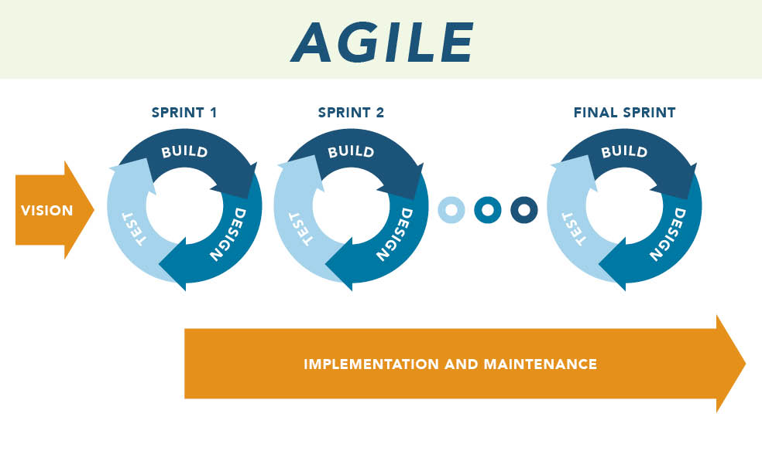
Agile Development Methodologies
Incremental development
Many small iterations
Each brings a set of working features
Feedback taken early
Customer collaboration
Less documentation
Agile requirements
User stories
Scrum
Kanban
Lean

Slide 9

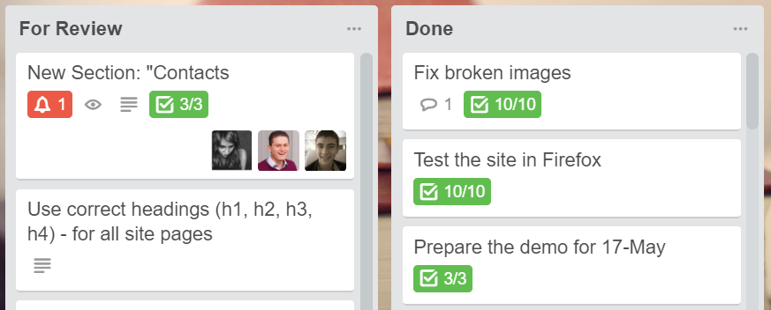
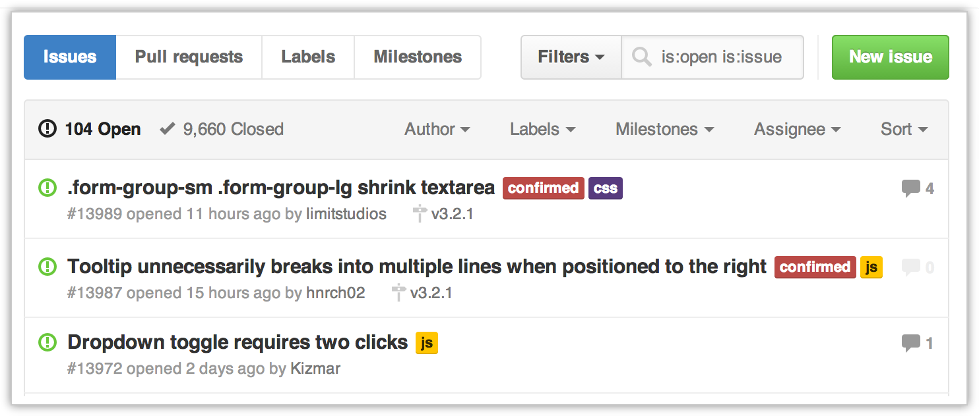
Software Requirements
Functional & Non-Functional Requirements, Requirements Specification, User Story Cards

Slide 10

Software Requirements
Software requirements describe the functionality and behavior of the software
Answer the question "what?", not "how?"
Define constraints on the system
Two kinds of requirements
Functional requirements
Non-functional requirements

Slide 11
Requirements Analysis
Requirements analysis starts from an idea about the system
Customers usually don't know what they need!
Requirements come roughly → adjusted during the development
Requirements change constantly!
The outcome is some requirements documentation
Software requirements specification (SRS) / user story cards / UI prototype / informal system description / etc.
Prototyping is often used, especially for the user interface (UI)

Slide 12

Software Requirements Specification (SRS)
The Software Requirements Specification (SRS) is a formal requirements document
SRS describes in details:
Functional requirements
Business processes
Actors and use-cases
Non-functional requirements
E.g. performance, scalability, hardware, integrations, constraints, security, etc.
Agile development
prefers user stories
SRS
SRS is too heavy!

Slide 13
Agile Requirements and User Stories
Dynamic projects use agile development methodologies
Formal specifications do not accept regular changes
Agile development needs agile requirements
Pieces of functionality, implemented in many small iterations
How to split the requirements?
Use simple, informal requirement descriptions
User story: a small feature that brings some value to the end-user

Slide 14
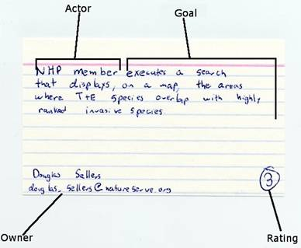
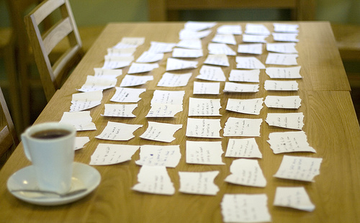
What is "User Story"?
User story
User needs to accomplish something
Written informally (in words / images / sketches)
Looks like a use-case but is less formal
User stories have
Actor (who?)
Goal (what?, why?)
Other info (owner, estimate, …)

Slide 15
User Stories – Examples
Cards in Kanban boards
Issues in the GitHub tracker

Slide 16
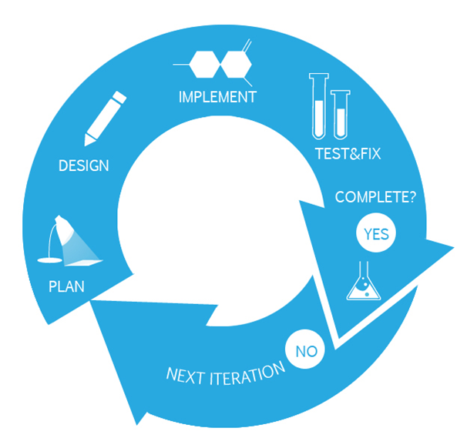
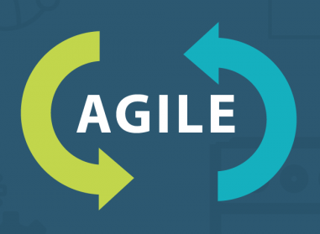
Software Requirements
It is almost impossible to describe and document the requirements in comprehensive way
Changes in requirements take time and money
Requirements always change during the project!
Agile methodologies are flexible to changes
Use stories are widely used in the agile world
Incremental development in small iterations
UI prototypes significantly reduce changes

Slide 17
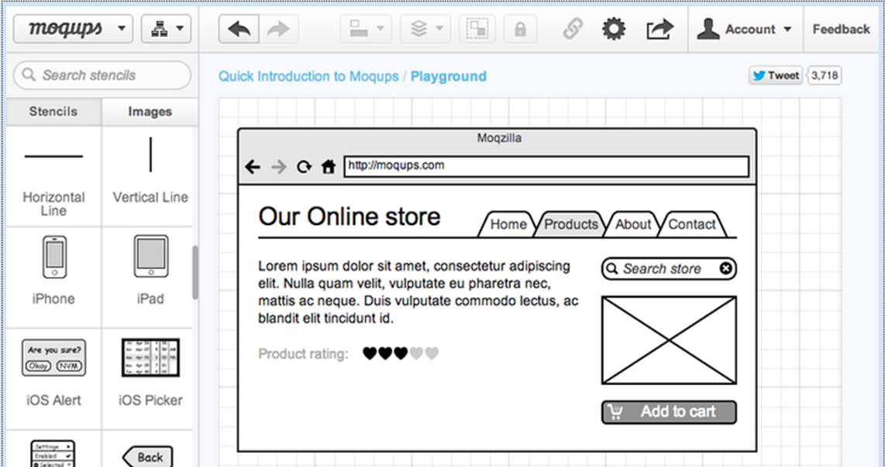
UI Prototyping
Sketch-Up Your UI Ideas

Slide 18
What is UI Prototype?
UI prototypes simplify creating software
User experiences the software before it is created
Problems / bugs / misunderstandings are resolved before the software is created (no code goes to the trash)
Wireframes / blueprints / mockups
Sketch-up the UI of the system in simplified way
Live prototypes
HTML / desktop app UI / mobile app UI

Slide 19
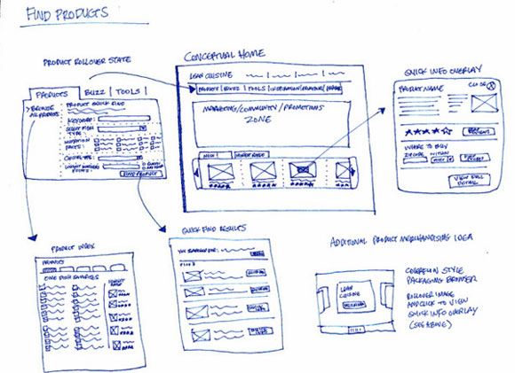
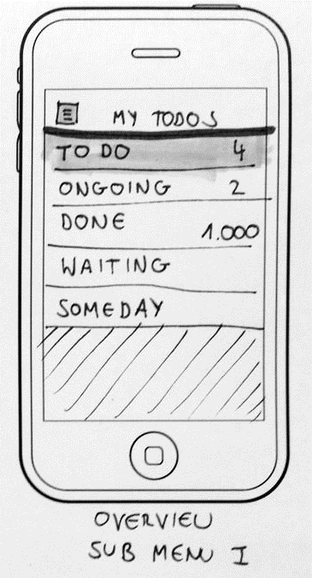
Hand-Made Prototypes (Paper + Pen)

Slide 20
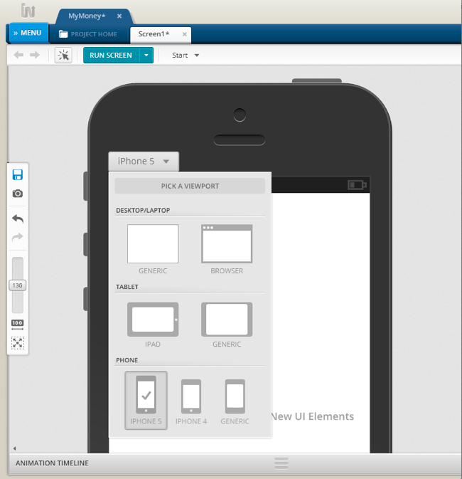
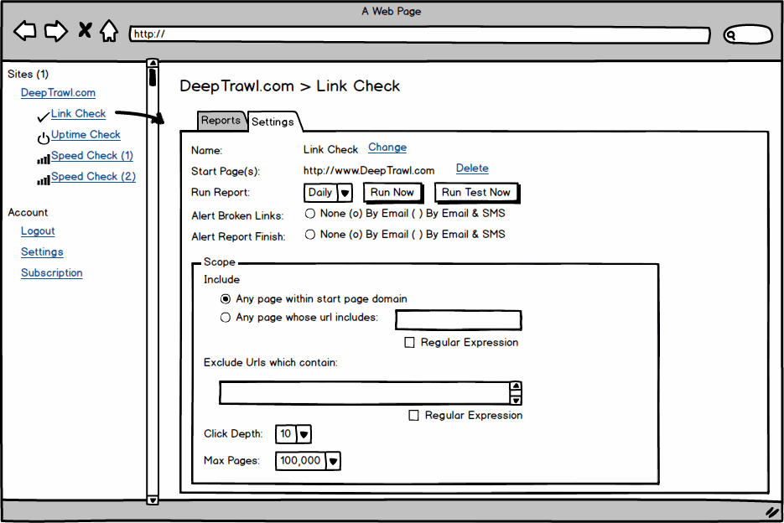
UI Prototyping Tools
Indigo Studio
Balsamiq Mockups

Slide 21
UI Prototypes
Live Demo

Slide 22
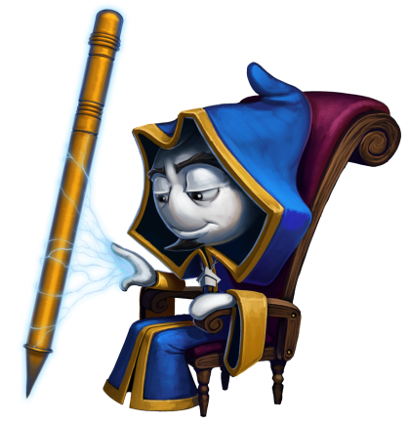
Creating a UI Prototype
Create a UI prototype for "TODO List" app
Login / register / logout
Add / edit / resolve / delete TODO items
Move items up / down
Live Exercises in Class (Lab)

Slide 23

Summary
Agile software development – the modern paradigm
Small iterations (sprints), delivering working features
Agile requirements
User stories → less formal, more flexible
UI prototypes → save development time
Kanban boards / project trackers
UI prototyping tools
Paper and pen, HTML, Indigo Studio, Balsamiq Mockups

Slide 24







Software Requirements and UI Prototyping
https://softuni.bg/courses/practical-teamwork

Slide 25
License
This course (slides, examples, demos, videos, homework, etc.) is licensed under the "Creative Commons Attribution-NonCommercial-ShareAlike 4.0 International" license

Slide 26





Trainings @ Software University (SoftUni)
Software University – High-Quality Education, Profession and Job for Software Developers
softuni.bg
Software University Foundation
http://softuni.foundation/
Software University @ Facebook
facebook.com/SoftwareUniversity
Software University Forums
forum.softuni.bg

